Slide 1

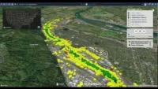


Kyle Onda (konda@lincolninst.edu)
Associate Director, Internet of Water

Slide 2
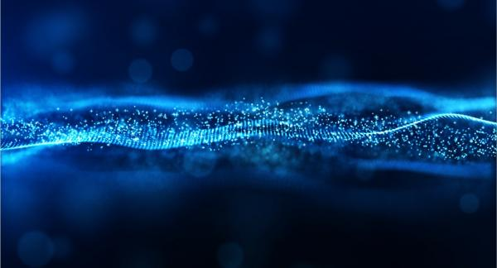










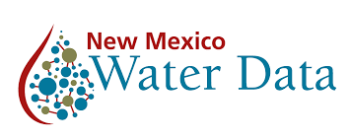

The Internet of Water: A vision for modern water data infrastructure connecting water data across the US so that it is Discoverable, Accessible, and Interoperable
A formal Coalition of organizations providing technology research, development, and socialization enabling the vision
A community of practice implementing the ideas developed in the Coalition, sometimes formalized as projects
NLDI

Slide 3
Motivations
“As a user of water data, I need to discover and access water information relevant to the environmental feature I care about from all the organizations that hold data about it, so I don’t have to have special knowledge to access some information and so I don’t miss some potentially relevant information.”
A water-specific search index that links data to geographic features like streams, watersheds, aquifers, and administrative boundaries
A free, open-source software suite that lets data providers automate the process of ingesting data, standardizing data, serving through an API, and serving relevant metadata
Guidance and basic data extraction tools that make it easier for users to access data from already existing hubs, such as Water Quality Portal
Dave Blodgett (USGS)
Second Environmental Linked Features Experiment: (https://docs.ogc.org/per/20-067.html
Notes:
Where does geoconnex come from. Basically it comes out of the intenrnational Stream of work at the open geospatial Consortium (the OGC) called the itneroperability experiments. Dave Blodgett from USGS had a leadership role in these experiments, the lessons of which form the core ideas behind geoconnex, and I work directly with him on this project. He also expressed the general motivating user story. “As a user of water data, I need to discover and access water information relevant to the environmental feature I care about from ALL organizations that hold data bout it, so I dont’ve have to have special knowledge to access osme information and so I don’t miss some potentially relevant information. Meaning basically, I want all the data but I don’t want to have to know where all that data lives ahead of time.

Slide 4
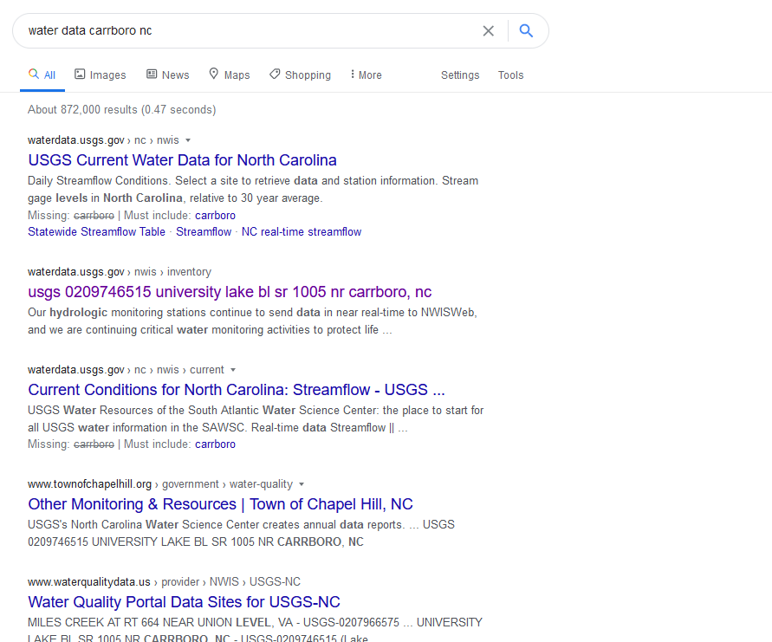
Currently…
A mix of structured and unstructured data
Dominated by USGS – administered systems
Dominated by state-wide views
Missing important topics and data providers
Like Internet Search Engines!
Via links
Notes:
The story is currently pretty different for water data. You have to know pretty much exactly what you’re looking for and who you want it from. If you were to do a general search for water data, you would get a mix of structured and unstructured data, most of it from USGS systems like NWIS or the Water Quality Portal, probably dominated by state- or nation-wide views of data without getting granular site-level information on your first look. And you’re probably missing important data providers as well as topics.

Slide 5
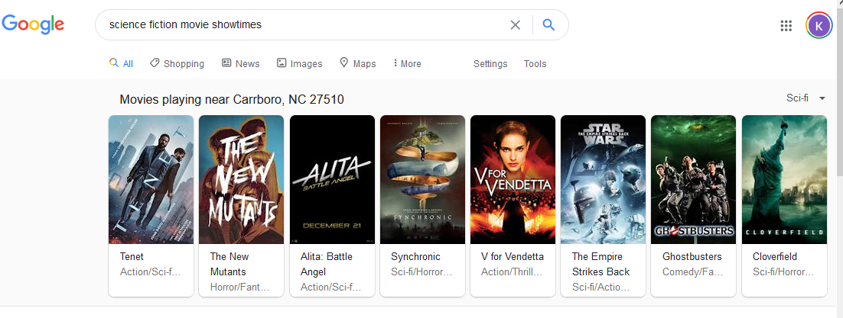
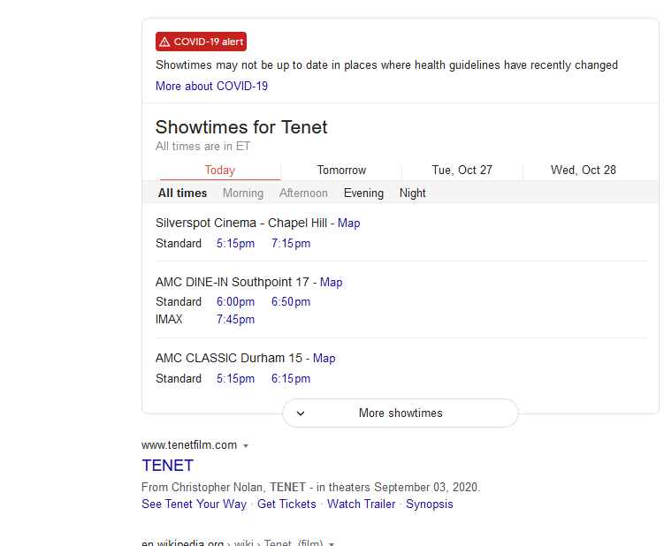
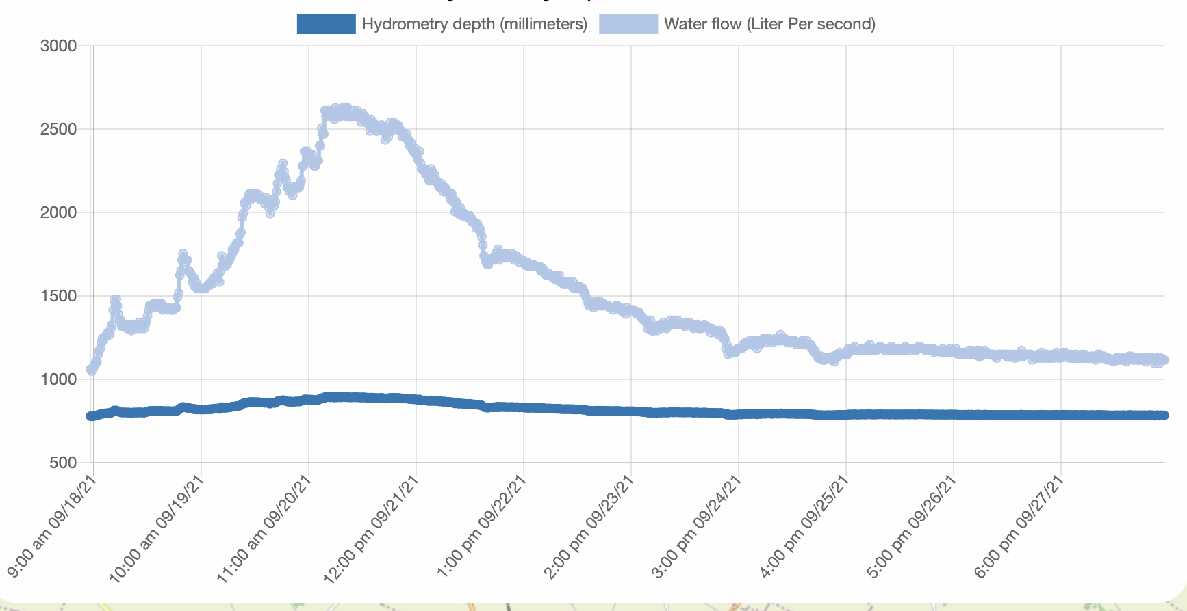
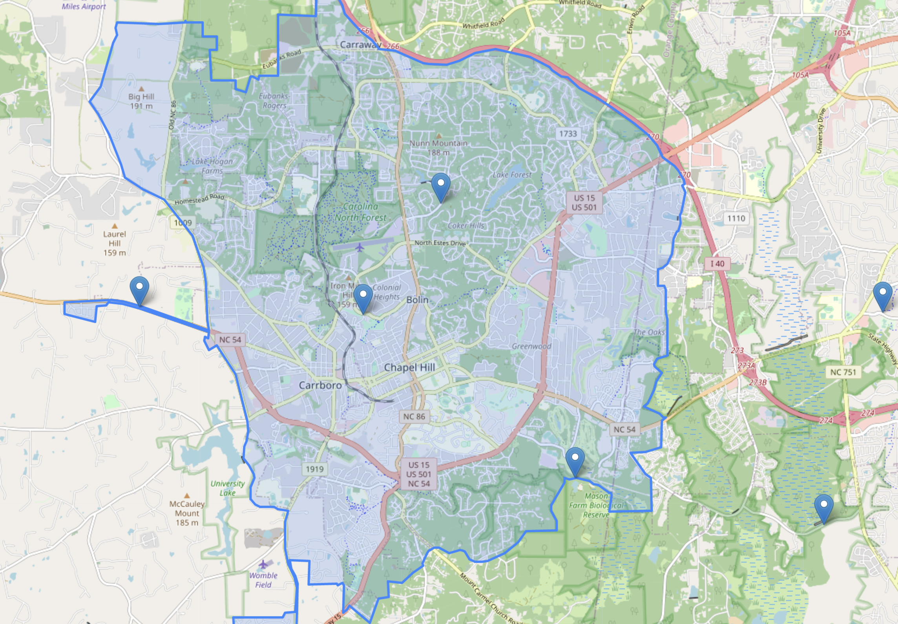
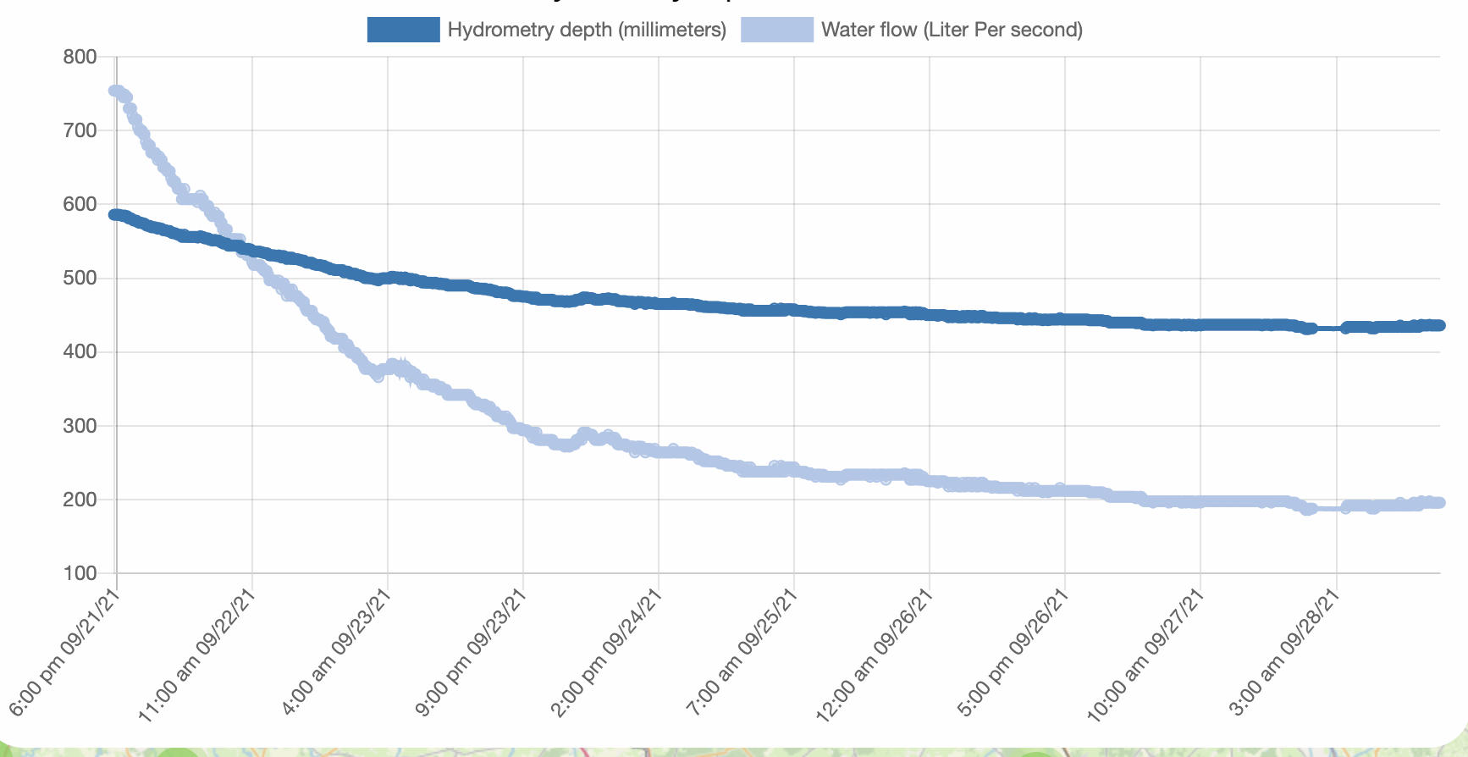
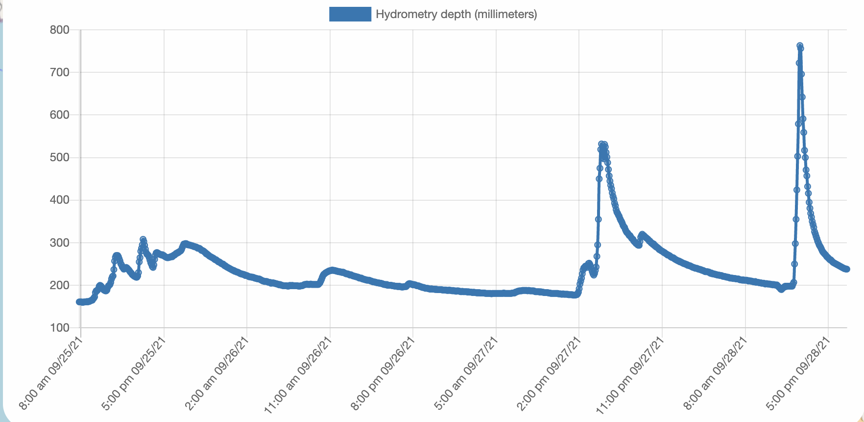
The Vision
Water data carrboro nc
Water data relevant to Carrboro, NC, 27510. Morgan Creek Watershed
Data that is...
DISCOVERABLE
Spatially - indexed
Topically - organized
Site-level granularity
No prior knowledge of water data providers required
Stream-flow
Precip- itation
Water Quality
Drinking Water Quality
Water Use
Like Internet Search Engines!
Via links
Streamflow near Carrboro NC
USGS Gages
Morgan Creek
Booker Creek
NC Department of Emergency Mgmt Gages
Station 1234B
Station 45x
Orange Water and Sewer Authority Gages
OWASA University Lake
Haw River Keeper
OWASA University Lake
Notes:
So what geoconnex aims to do is leverage the technology that is already used to organize a variety of commercial information for the purposes of making water data much more findable to both lay users and academic and professional users. You can imagine being bale to search for water data And having metadata organized for oyu by theme or topic, and having data from ALL organization well organized and presented for you. For example, you should be able to easily find data from streamgages, bot only from USGS, but also state and local agencies.

Slide 6
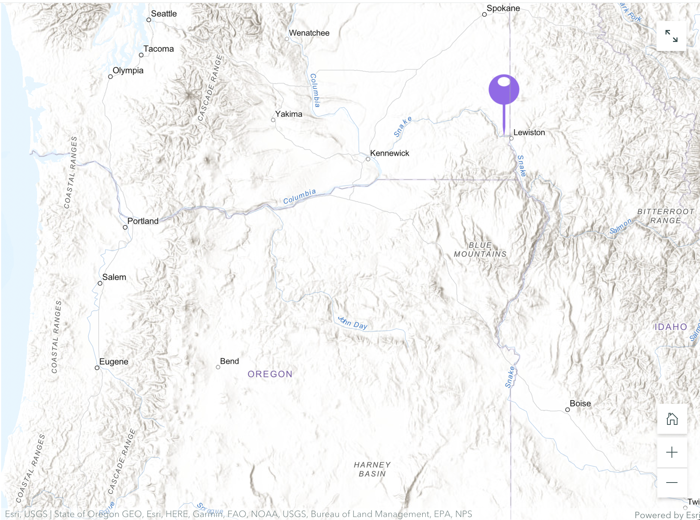
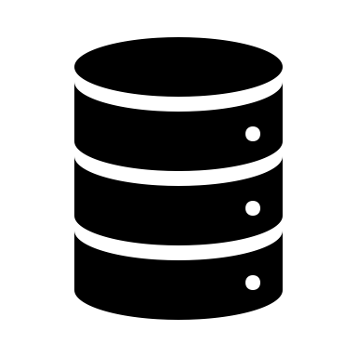
Workflow Vision (Development by WaDE)
I want all real-time, historical, and model/forecast data from hydrologically relevant in the past 30 days regarding:
Quantity
Quality
Use
Dashboard
Water diversions time series data

Slide 7
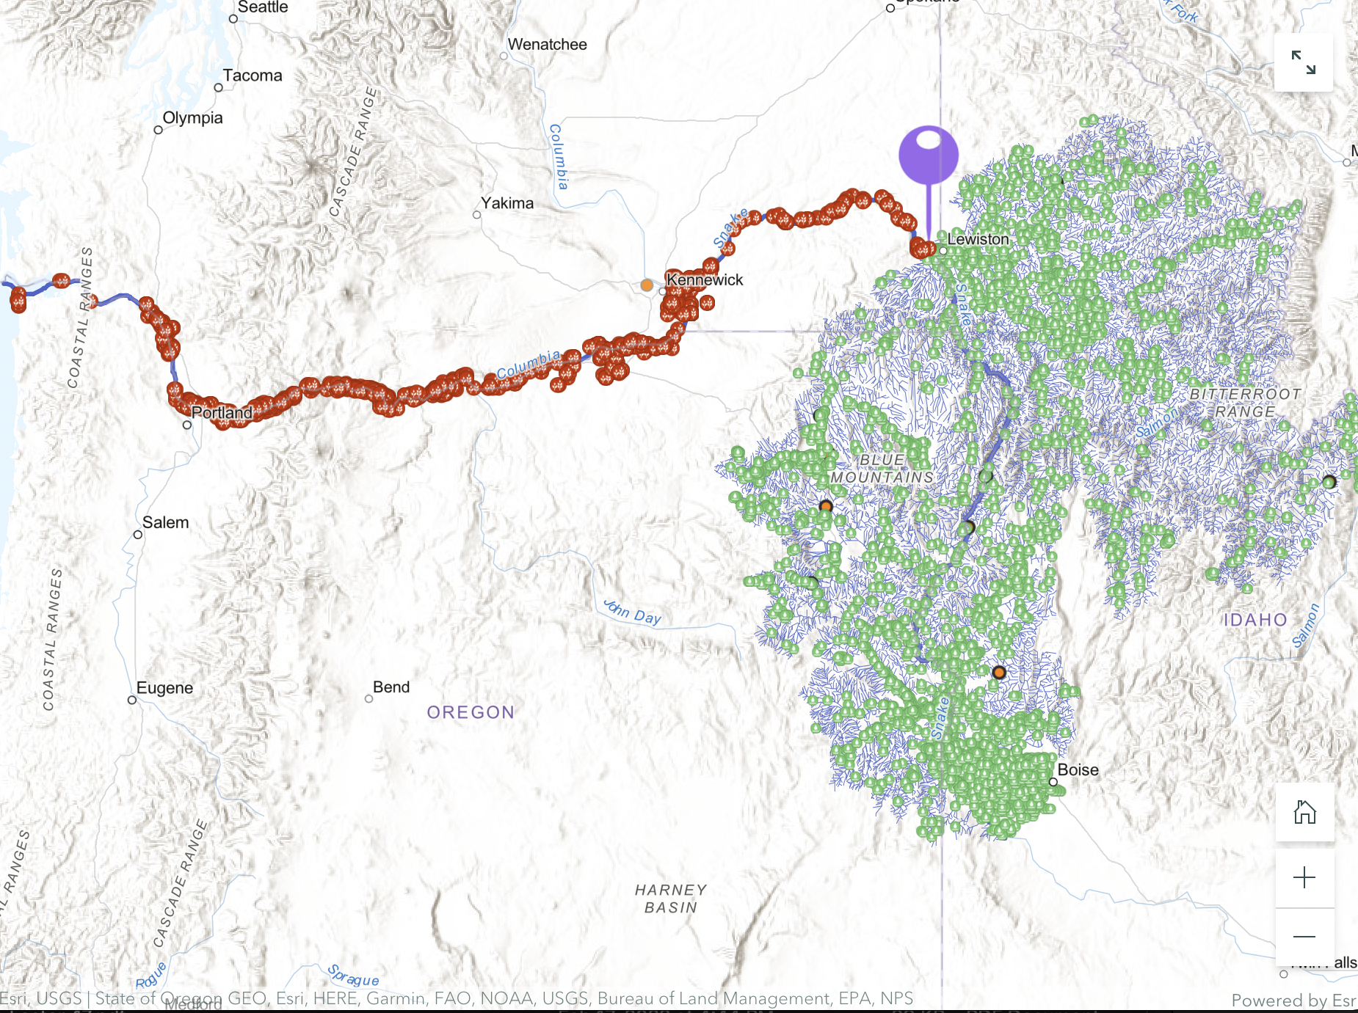
Workflow Vision (Development by WaDE)
Network Linked Data Index
Water diversions time series data
*Diversion Sites
*Monitoring Locations

Slide 8

Workflow Vision (Development by WaDE)
Network Linked Data Index
Water diversions time series data
*WaDE Diversion Sites
*Monitoring Locations

Slide 9
Workflow Vision (Development by WaDE)
Network Linked Data Index
geoconnex knowledge Graph
Water diversions time series data
*WaDE Diversion Sites
*Monitoring Locations

Slide 10

Workflow Vision
Network Linked Data Index
geoconnex knowledge Graph
USGS data services
State
data services
Water diversions time series data
*WaDE Diversion Sites
*Monitoring Locations

Slide 11
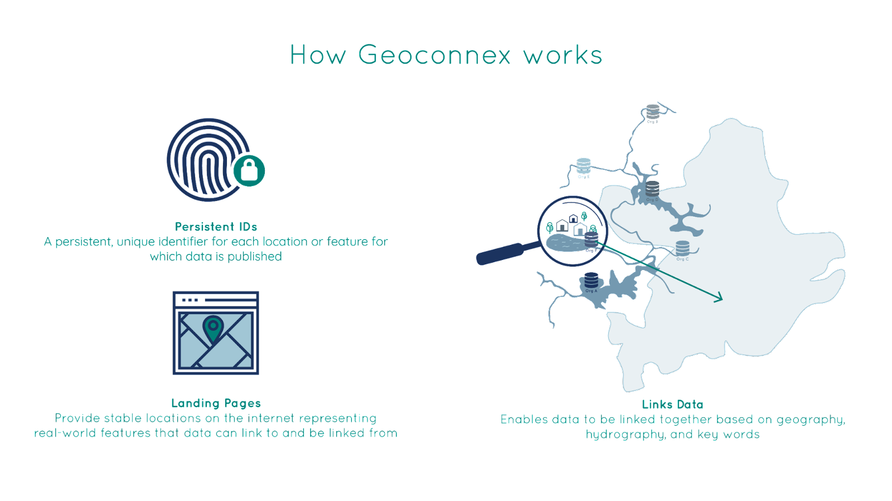
https://geoconnex.us
(persistent identifier registry and resolver)
https://geoconnex.us/sitemap.xml
Reference
Features
Special features common across organizations (e.g. stream network, admin geographies)

Slide 12


https://geoconnex.us
(persistent identifier registry and resolver)
https://geoconnex.us/sitemap.xml
Reference
Features
Organizational
Monitoring locations
Embedded
JSON-LD
”I am a https://geoconnex.us/usgs/gage/1234”
“I am a gage”
“I’m from USGS”
“I am on this spot on NHDPlusV2 (stream network)
“USGS has near-real-time data here formatted like so
Datasets
”I am a model point of interest”
“I’m from NOAA”
“I am on this spot on NHDPlusHR,
“NOAA has forecast data here formatted like so

Slide 13
https://geoconnex.us
(persistent identifier registry and resolver)
https://geoconnex.us/sitemap.xml
Reference
Features
Embedded
JSON-LD
Organizational
Monitoring locations
docs.geoconnex.us
JSON-LD guidance, templates, schemas, vocabularies. Derived from SELFIE (HY_Features, schema.org, SOSA/SSN)

Slide 14


harvest.geoconnex.us
https://geoconnex.us
(persistent identifier registry and resolver)
https://geoconnex.us/sitemap.xml
Reference
Features
Knowledge graph
(graph database)
APIs
Embedded
JSON-LD
Organizational
Monitoring locations
search.geoconnex.us
graph.geoconnex.us
reference.geoconnex.us
docs.geoconnex.us
JSON-LD guidance, templates, schemas, vocabularies. Derived from SELFIE (HY_Features, schema.org, SOSA/SSN)

Slide 15
harvest.geoconnex.us
https://geoconnex.us
(persistent identifier registry and resolver)
https://geoconnex.us/sitemap.xml
Reference
Features
Knowledge graph
APIs
Embedded
JSON-LD
Organizational
Monitoring locations
Datasets
”I am a reference location”
“I am on this spot on NHDPlusV2,
and this one on NHDPlusHR”
“USGS has near-real-time data here”
“NOAA has forecast data here”
“NMED has other data upstream here”
docs.geoconnex.us
JSON-LD guidance, templates, schemas, vocabularies. Derived from SELFIE (HY_Features, schema.org, SOSA/SSN)

Slide 16
What we need for this
Common semantics and API patterns for WQ data across orgs
Common semantics for expressing relationship of WQ data to real-world hydrologic features (eg referencing HY_Features)
Web publication of interoperable site-level metadata (implement SELFIE)

Slide 17

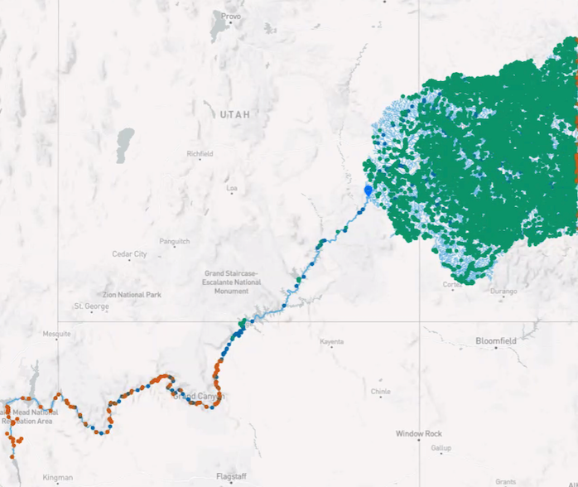
What is the NLDI?
A RESTful application programming interface (API) in front of the NHD (NHDPlusV2 for now, HR support eventually)
Based on the code and hydrologic addressing framework of the USEPA RAD and WATERS database and API
An open-source project with the codebase available at https://github.com/internetofwater/nldi-services
Hosted by USGS
https://labs.waterdata.usgs.gov/about-nldi/index.html
Anyone can contribute!

Slide 18
NLDI and Geoconnex – Emerging applications

Slide 19
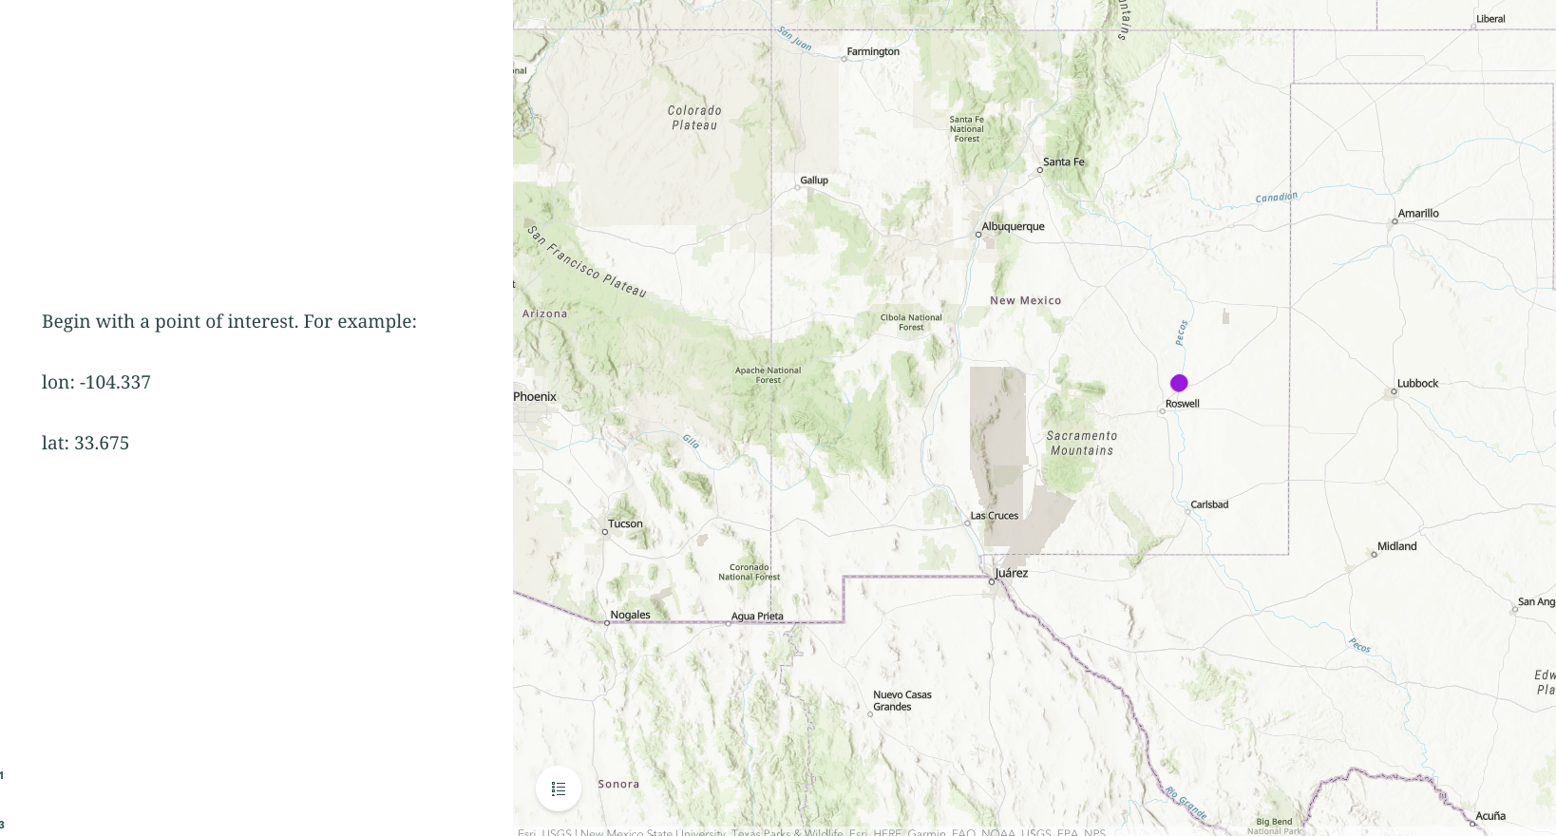

Slide 20
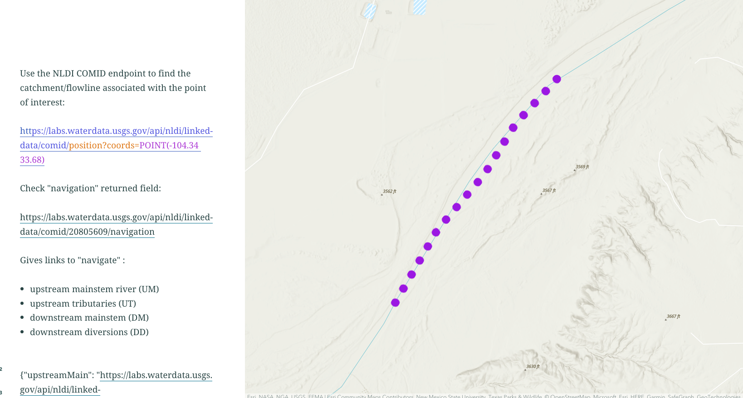

Slide 21
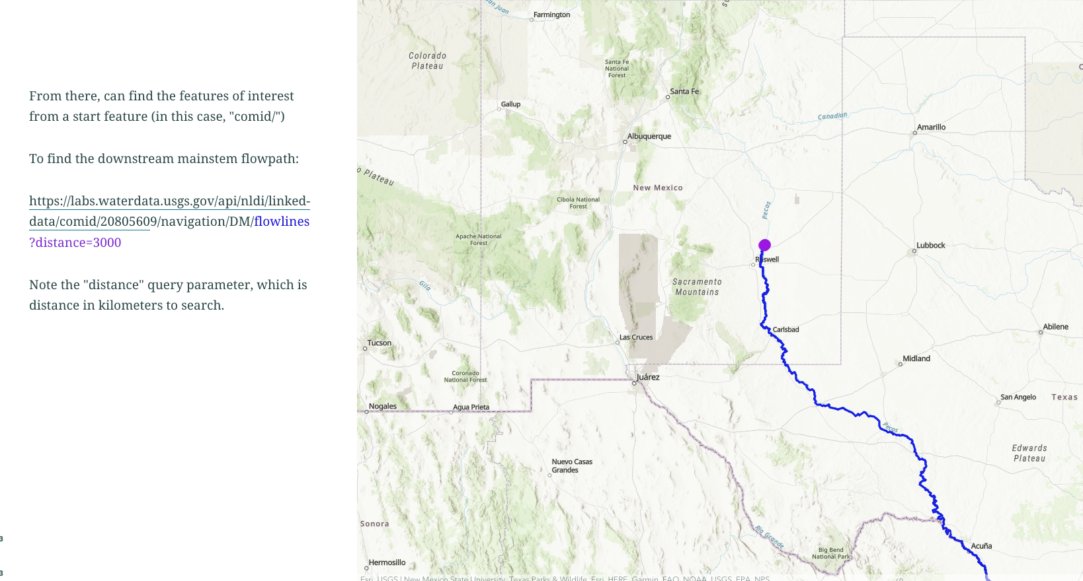

Slide 22
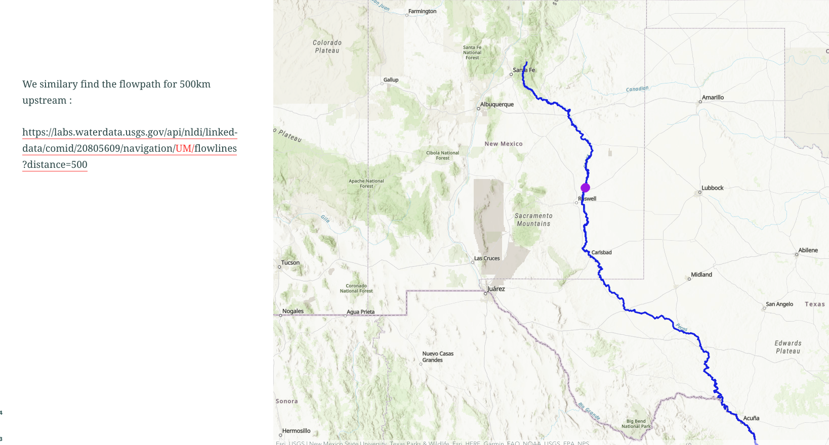

Slide 23
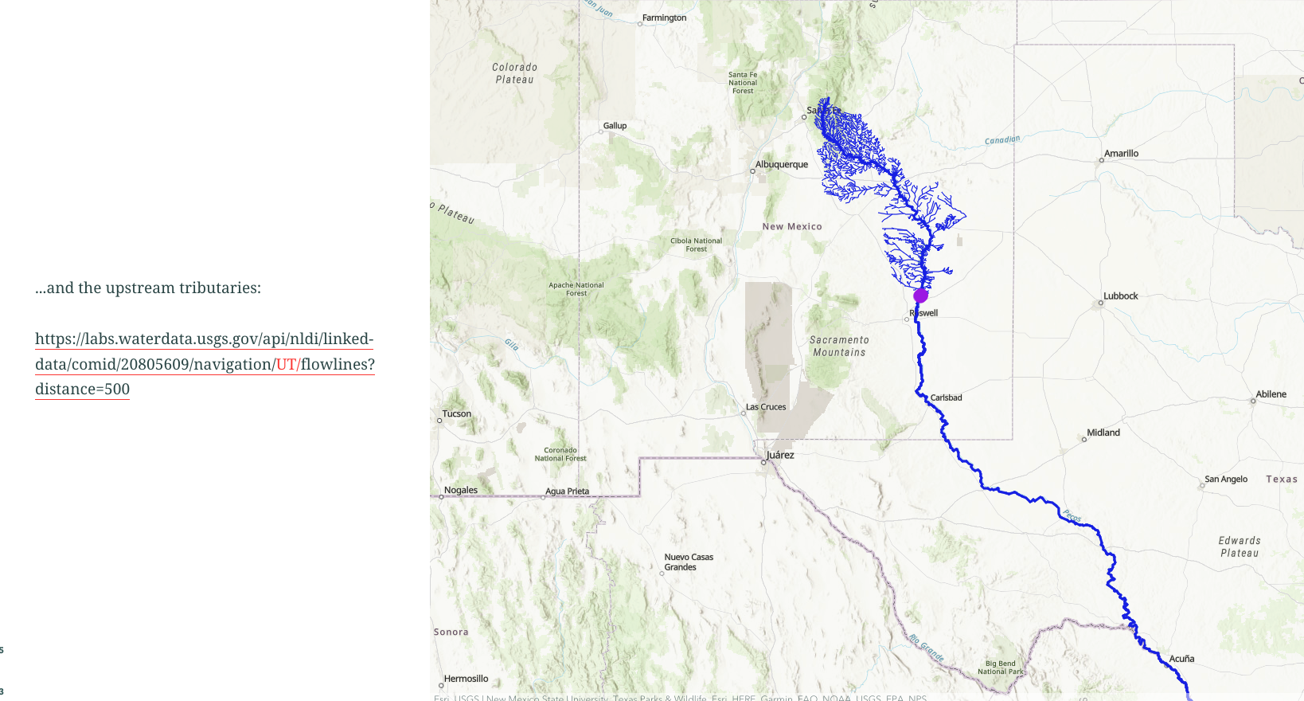

Slide 24
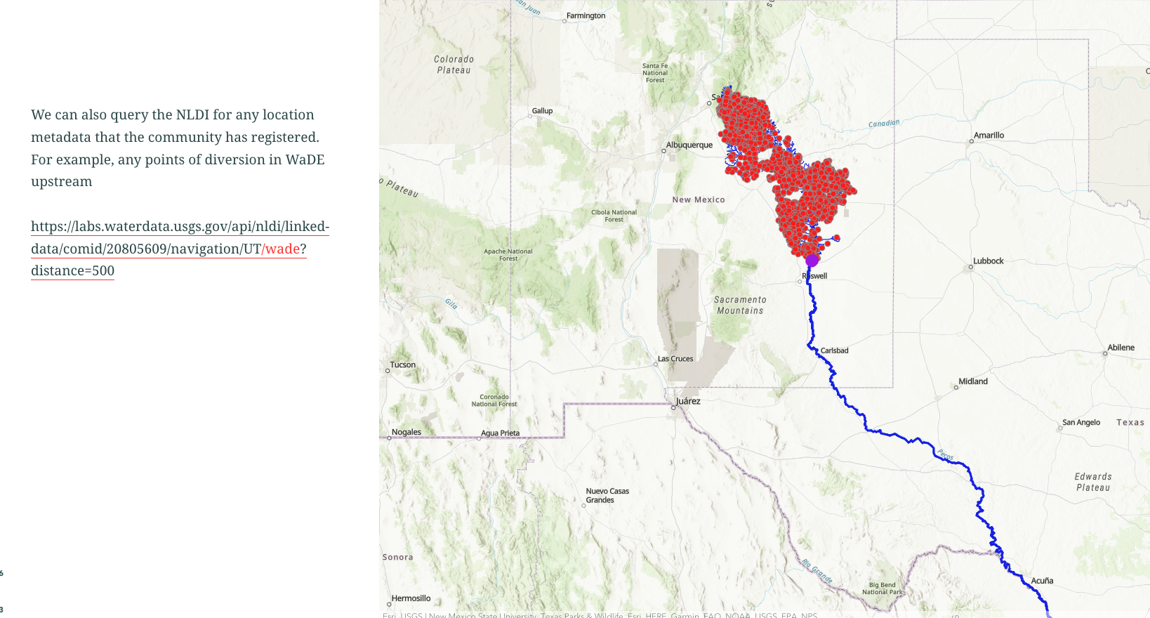

Slide 25
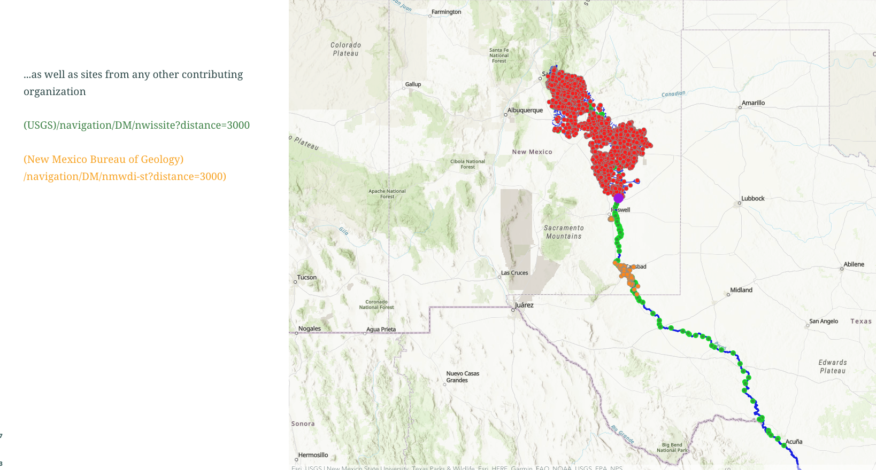

Slide 26
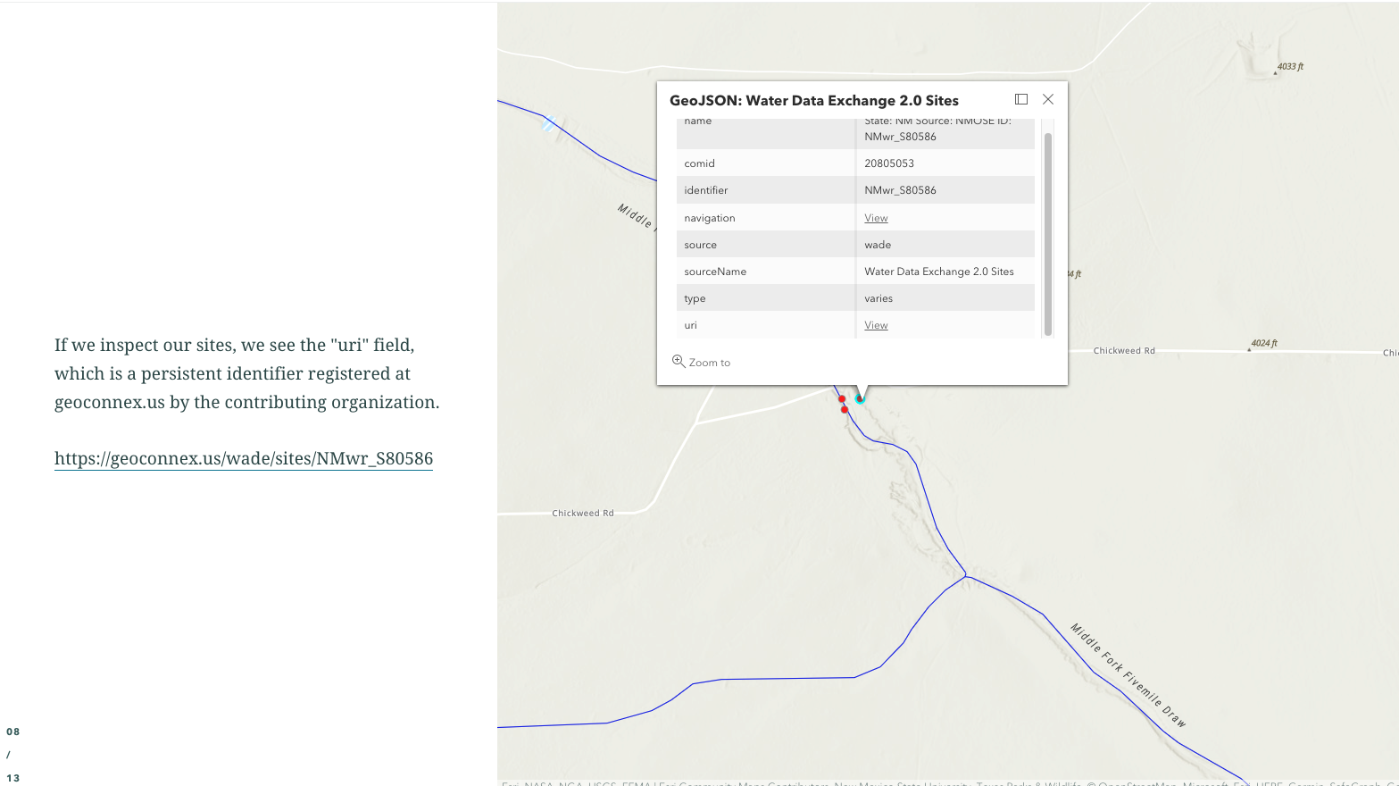

Slide 27
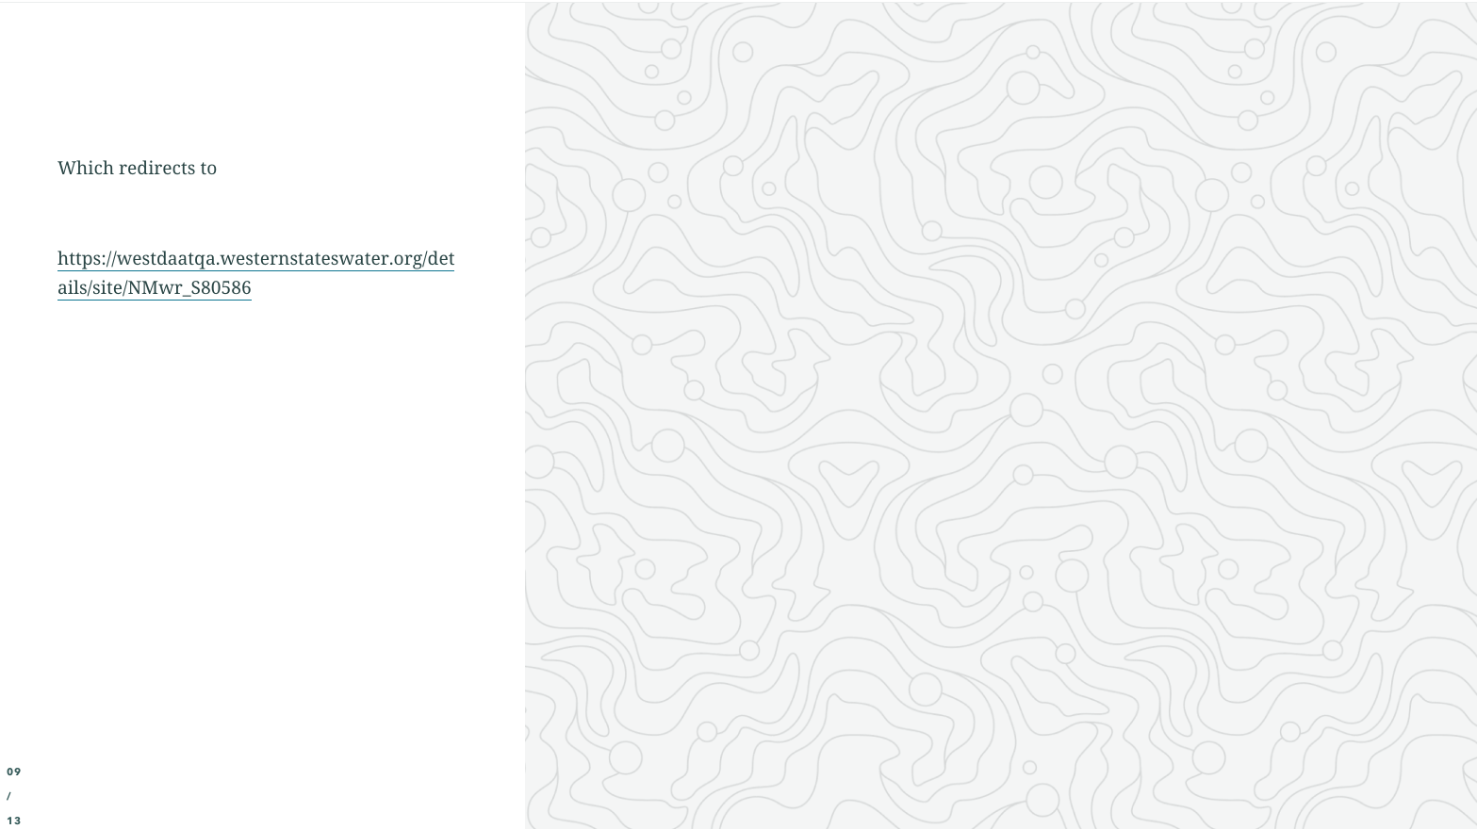
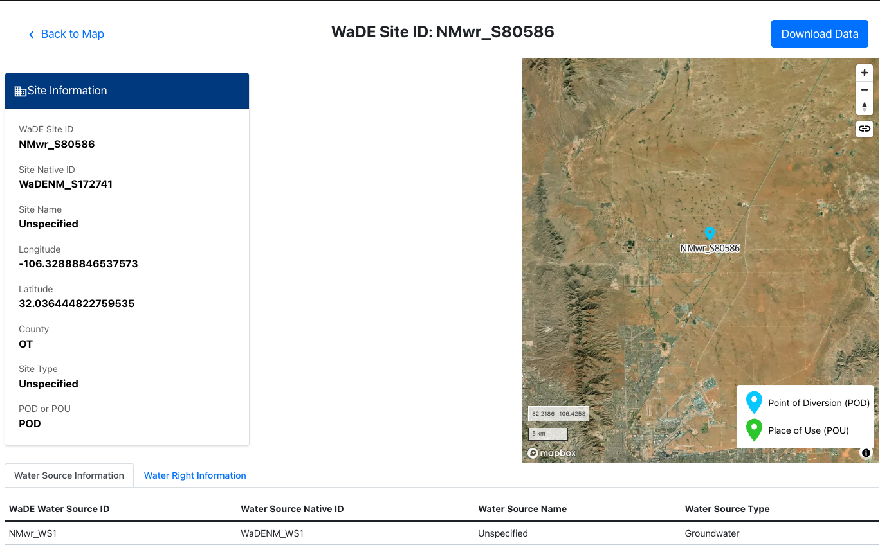

Slide 28
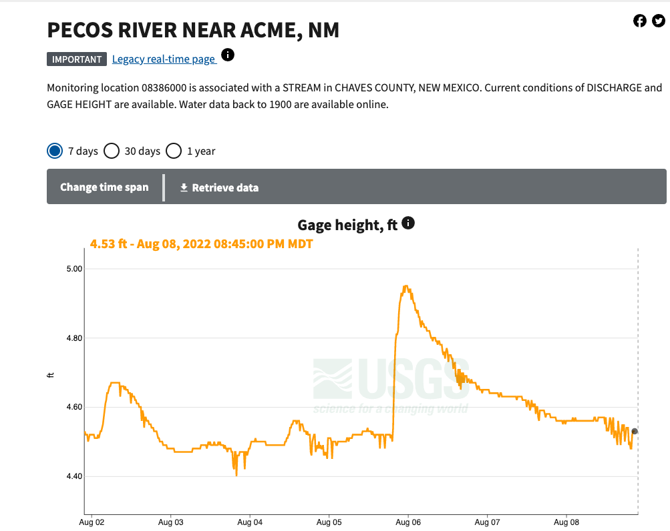
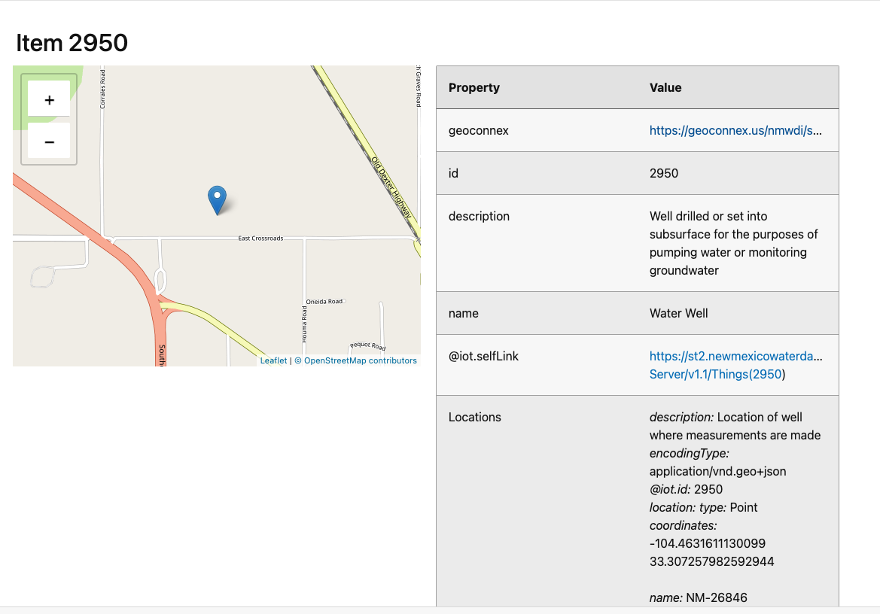
Current work
USGS uri
NMWDI/OSE uri

Slide 29
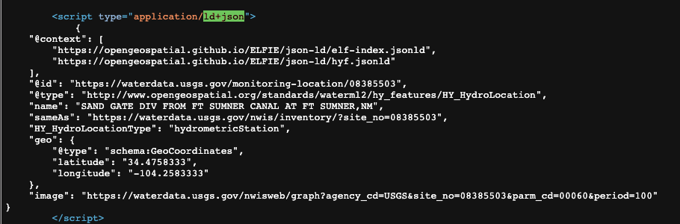
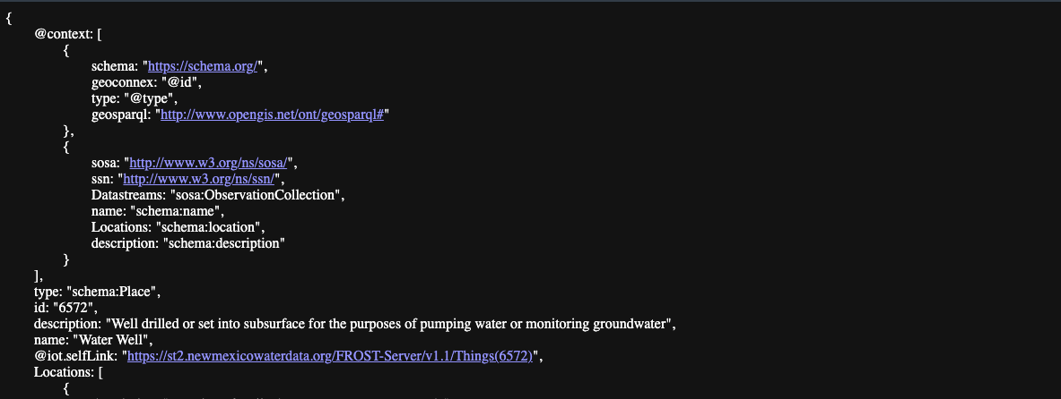
Current work
USGS uri (JSON-LD)
NMWDI uri (JSON-LD)

Slide 30
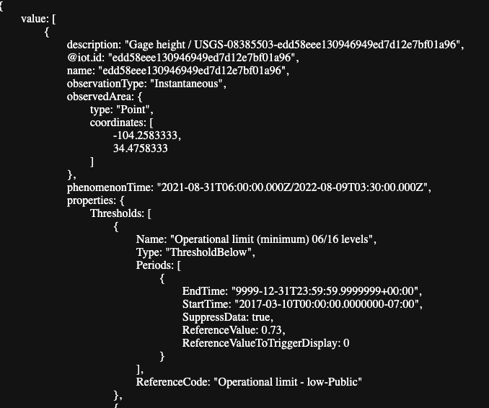
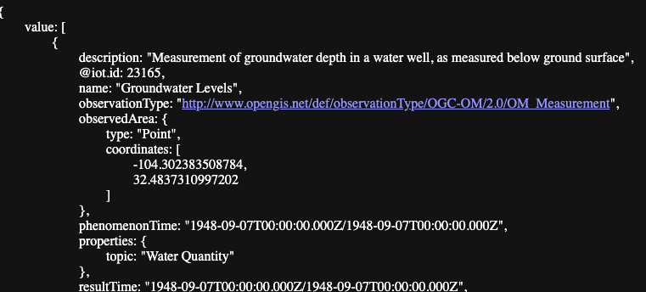
Current work
USGS uri (JSON-LD)
NMWDI uri (JSON-LD)
Link to SensorThings API endpoint for measured streamflow
Link to SensorThings API endpoint for measured withdrawals/pumping/groundwater levels

Slide 31
Current work
USGS uri (JSON-LD)
NMWDI uri (JSON-LD)
Link to SensorThings API endpoint for measured streamflow
Link to SensorThings API endpoint for measured withdrawals/pumping/groundwater levels
Need alignment

Slide 32
Future work
More participation in the system
USBR RISE
Water Quality Portal
Oak Ridge National Lab (hydropower data)
Texas Water Development Board
Others??
Notes:
- (eg media, parameter, method, lab/sensor metadata, period of record, data quality codes)

Slide 33
Ideal outputs from the WQIE for the Internet of Water
Interoperable (SensorThings? OAF? EDR?) API endpoints for continuous and sample data from USGS, USEPA/ WQX, and New Mexico state agencies.
Best practices for WQ in STA, OAF, EDR that we can give to federal and state agencies
Specs for expressions of WQ station metadata including location, organization, hydrologic location (referencing HY_Features), parameter, and period of record, etc available in JSON-LD, w/ implementation by USGS, EPA, + New Mexico agencies. (Implement with STA or OAF as data back end?)
Possible: tooling to express/proxy STA endpoints as EDR
Notes:
- (eg media, parameter, method, lab/sensor metadata, period of record, data quality codes)

